Slide 1
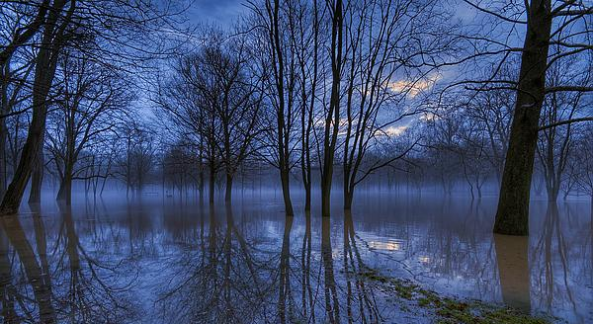

Draining the Data Swamp
Tyler Skluzacek, Paul Beckman, Kyle Chard, Aaron Elmore, Ian Foster

Slide 2
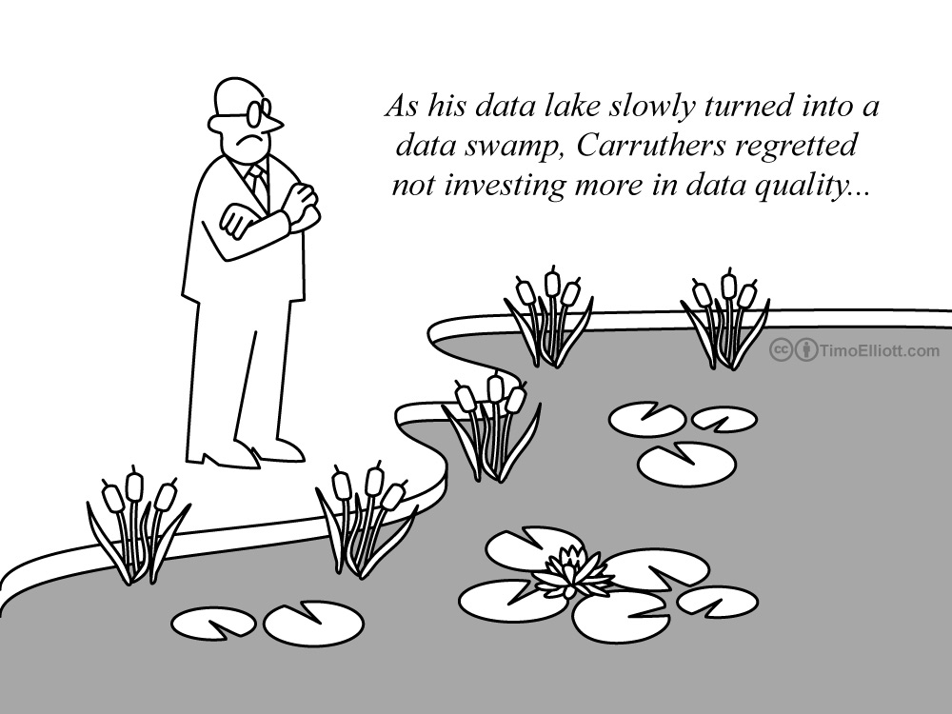

Slide 3
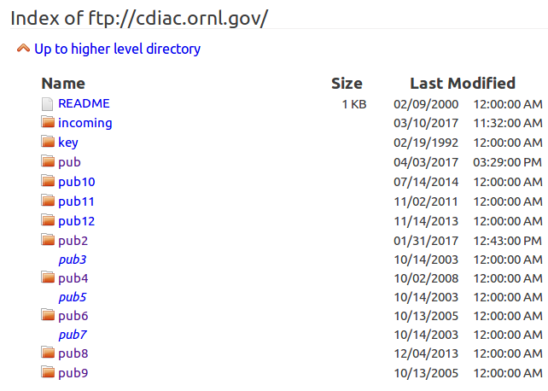
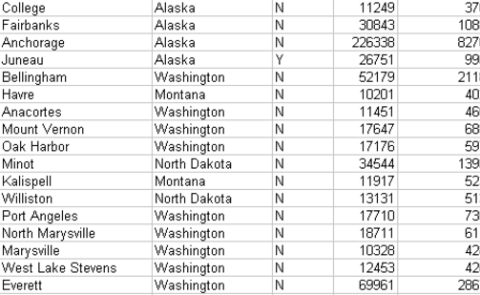

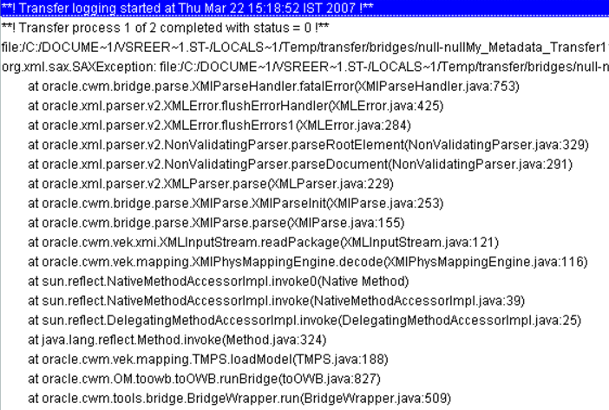

Dealing with Data Pollution

Slide 4
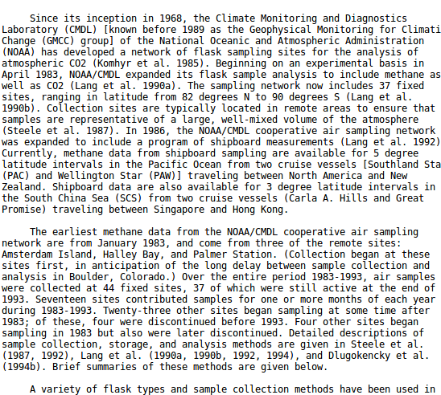
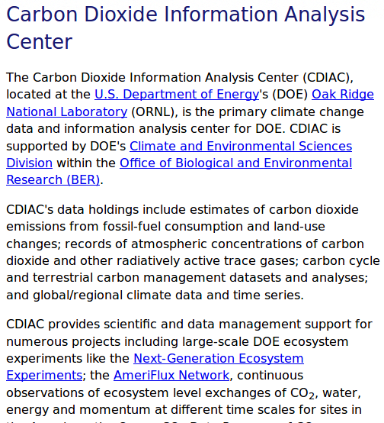
Context

Slide 5
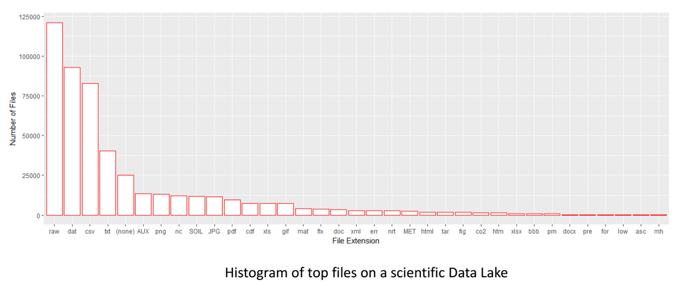
Solution: Drain the Data Swamp
Data Wrangling / Ad Hoc Metadata Gymnastics
Content vs. Context

Slide 6
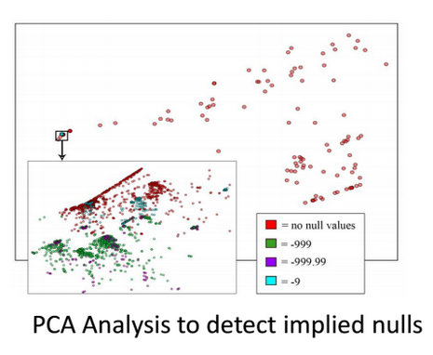
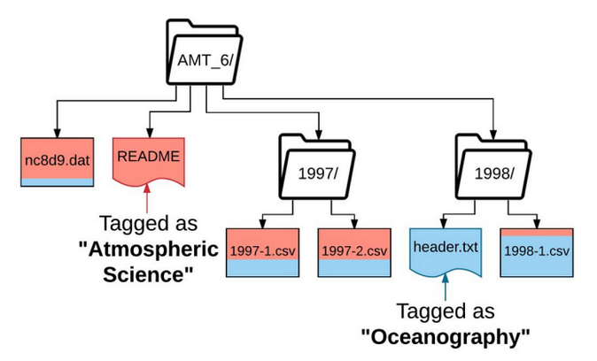
Skluma… and beyond!
Metadata and Schema Extraction
Need to be both fast and accurate (i.e., efficient)
Defeat nulls and headerless ‘nonsense’
Crawl data for contextual relationships
Fixed use case: CDIAC
500,000+ files, 150+ file types

Slide 7
The Future
Extraction of image features for topic assignment
Interactive metadata enrichment
“People are lazy, metadata is hard”
Creating conversations between chatbots and scientists
Expand our use case to… wherever is biggest.

Slide 8
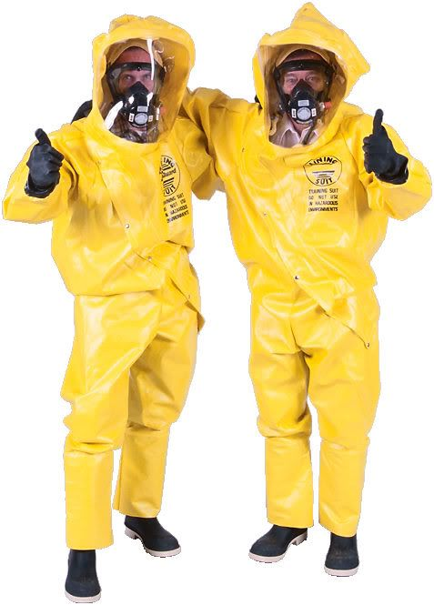
Conclusion
The Data Swamp is growing --- it needs to be drained.
Building scientific repo enhancers.
Remove the trash
Supplement the good stuff
Move on to bigger and better (worse) data.

